Slide 1

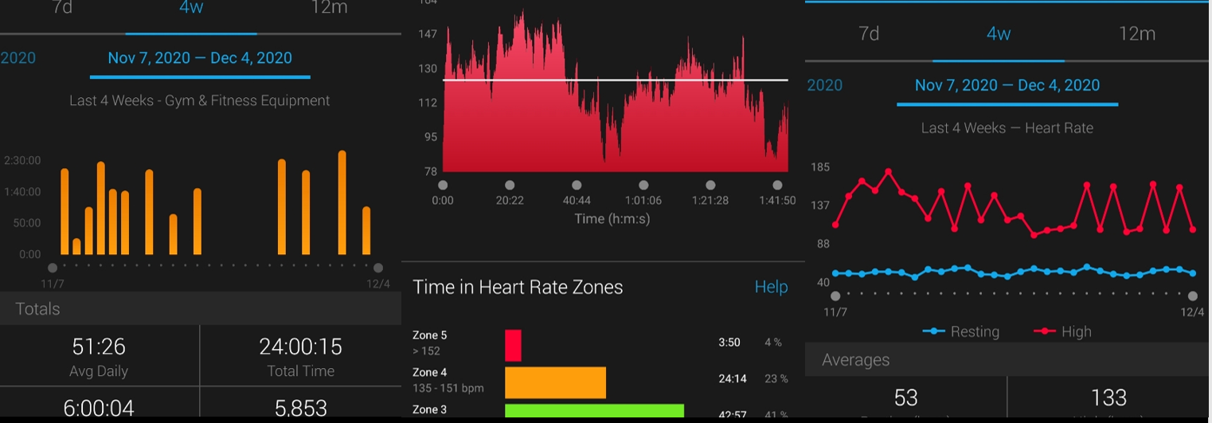
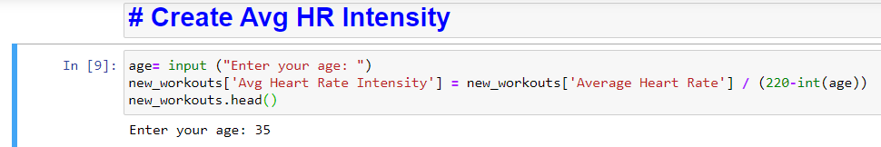
Apple health dashboard
A visualization tool to help clinicians interpret patient exercise data
Brandon Lade
Jacqueline Warren
https://github.com/ksu-hmi/Apple-Health-Dashboard

Slide 2
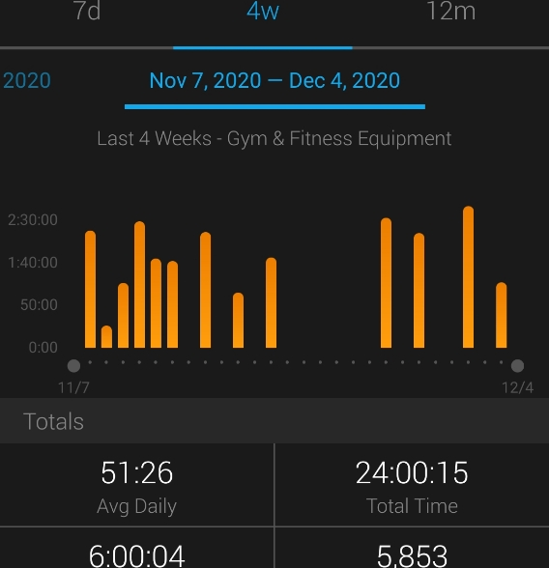
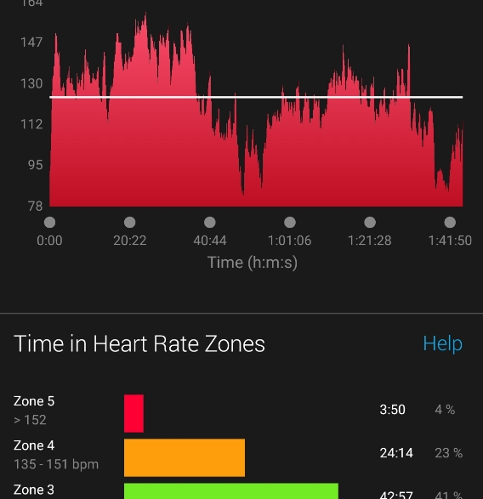
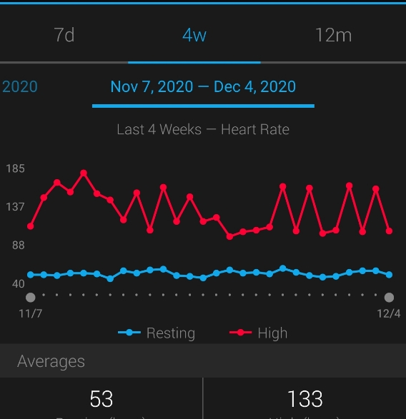
Dashboards

